Slide 1
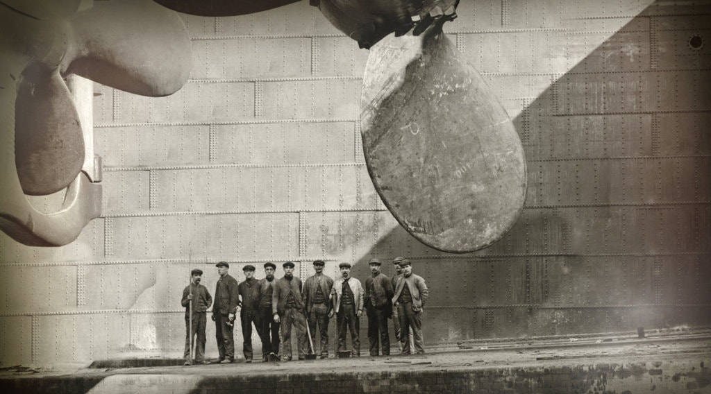

Titanic Crew Member Survival Data
Exploring the Untold Story of the Ship’s Workers
Notes:
On the night of April 14 1912, on her maiden voyage from England to the United States, the ocean linter RMS Titanic — at the time, the world's largest ship — struck an iceberg, and sank in the early hours of April 15th. Only 706 of her 2,224 passengers and crew survived. The tragedy of Titanic was the catalyst for major reforms in shipping safety, and is arguably the most famous maritime disaster ever, being the subject of numerous media portrayals, including the 1997 blockbuster Titanic by James Cameron, which went on to break nearly every box-office record when it was released. The story of Jack and Rose and the tragedy of the ship’s sinking is captivating for sure, and it helped introduce the very real story of the ship to new generations of people all over the world. There have been many stories and recorded history of the ship’s passengers and their outcomes.
But what about the crew members? What about the people who worked aboard the ship, what is their story? I took on this project because I specifically wanted to know about the survival rate of Titanic’s crew. How many total crew members were there and how many survived? How many were men and how many were women? In which parts of the ship did they work? At which port did they board the ship and did that impact if they survived or not?

Slide 2
Construction
Notes:
Before we get into the specifics of the survival data of Titanic’s crew, I think it’s essential to help set the tone for the magnitude of this tragedy. At the time of the ship’s sinking on that cold night in April 1912, Titanic was not only the largest ship to have set sail and the largest ship to have sunk, it was also the largest man-made created moving object of its time. But let’s back up a few years.
In the early 1900’s, White Star Line, a shipping company based out of Liverpool, England, wanted to transform the trans-Atlantic ocean passenger line industry. There was a race to create the best and fastest ocean-faring vessels to move people, products, and mail across the world, and White Star contracted with Harland & Wolff Shipyards out of Belfast, Ireland to bring their grand ideas to life. In early 1909, thus began the creation of not just one, but three opulent ocean liners: Olympic, Brittanic, and Titanic.

Slide 3
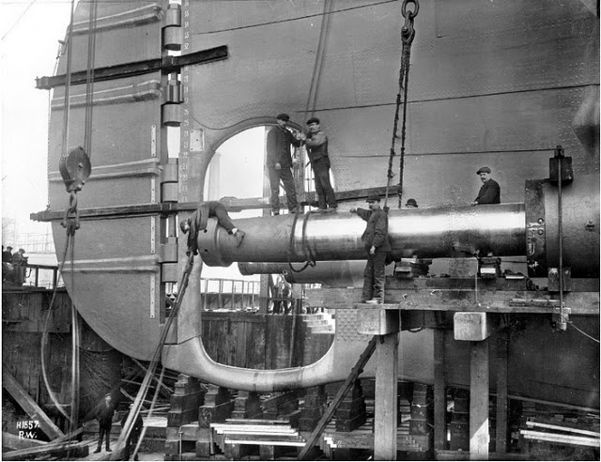
3
years
15,000 shipbuilders
3,000,000
rivets
Construction
Notes:
Construction of Titanic began on March 31, 1909 when designer James Andrews laid the first keel plate in the Harland & Wolff Shipyards in Belfast, Ireland. Titanic’s sister ship, Olympic, had begun some three months earlier and the two ships were essentially constructed side-by-side by a shipbuilding crew of over 15,000 workers. Oh, that 3 million rivets number you see there? Those were to connect the 1 inch steel plates that made up the hull of the ship. Every single one of them was hand-hammered into place. There was no automation in this day and age. It was laborious, tedious, grueling work to create something of this scale and magnitude.
Unfortunately, it was not only the ship’s maiden voyage that resulted in loss of life — during construction of Titanic, eight employees lost their life doing the work of creating such a massive ship at an even more mammoth — and often dangerous — construction site. When Titanic was designed, no facilities on Earth existed to build or berth such a large ship. They had to be created.

Slide 4
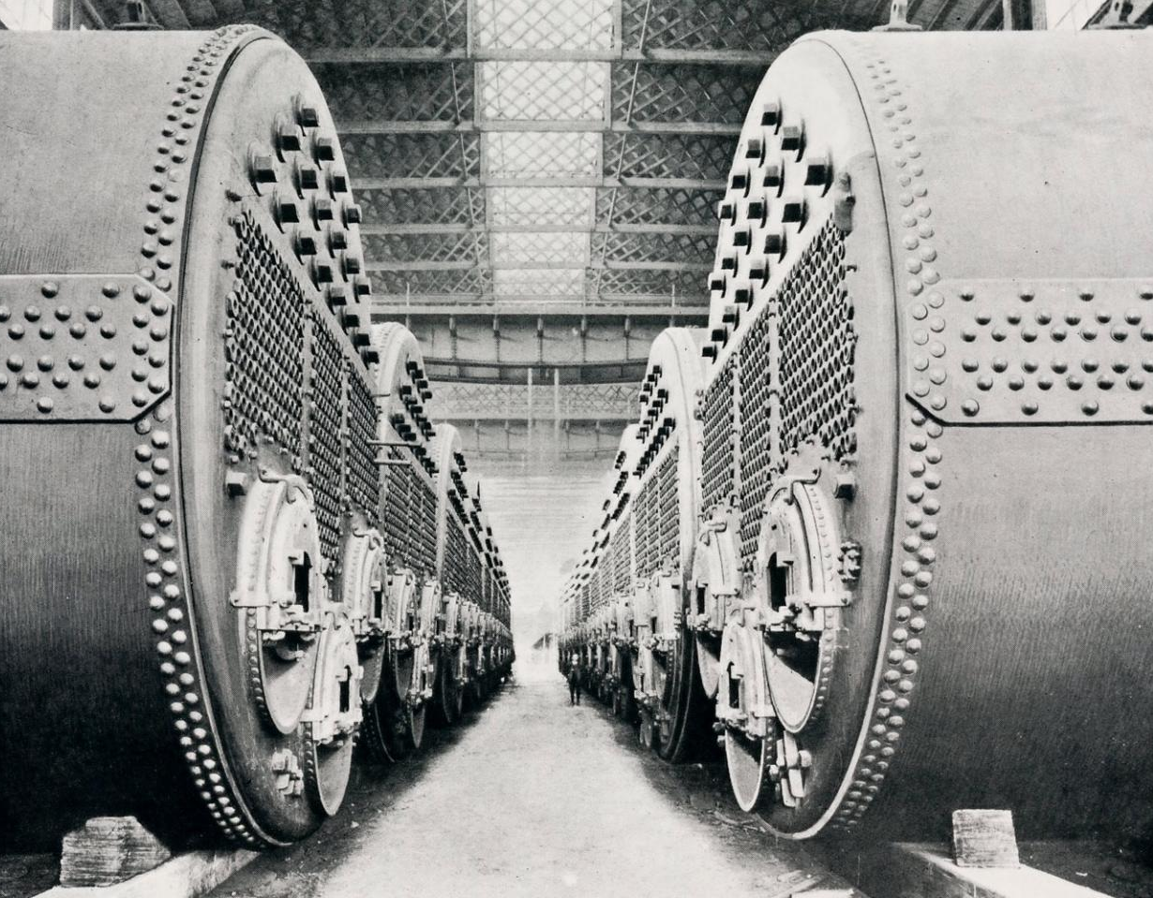
24
double-ended boilers
5
single-ended boilers
6
boiler rooms
Boilers
Notes:
To power the largest movable structure ever made would require an enormous power source, and in the early 1900’s that source was coal-powered steam. There were twenty-four double-ended Scotch class boilers and a further five single-ended boilers which were housed in six boiler rooms. The double-ended boilers measured 20 feet long, with a diameter of 15 feet 9 inches and contained six coal burning furnaces. The single-ended boilers were 11 feet 9 inches long with the same diameter. With all boilers firing, Titanic produced around 46,000 horsepower, generating 22 knots of speed, which is equivalent to around 25 mph. The massive size of the ship’s boilers proved prominent in August of 1985, as it was one of these boilers that was spotted at the bottom of the North Atlantic that led to the discovery of the resting place of the ship, over 73 years after it struck an iceberg and sank over two and half miles down to the bottom of the ocean floor.

Slide 5
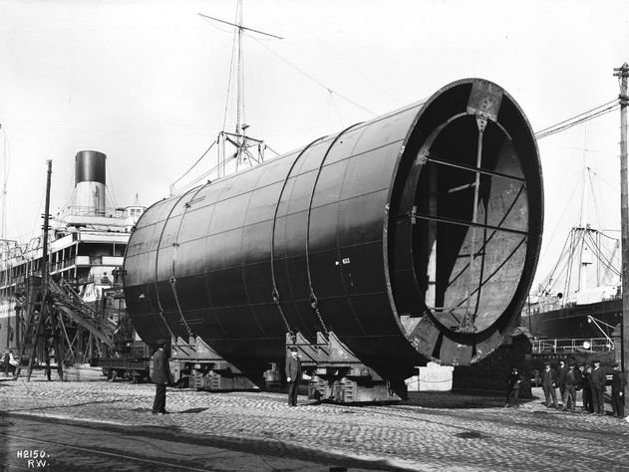
4
funnels
3
functional
1
purely aesthetic
Funnels
Notes:
Builder Thomas Andrews’ original design of Titanic was so efficient that it was originally conceived with only three funnels to service the massive boilers some 15 stories below. However, White Star Line, the owner of Titanic, thought it a necessity that a ship of such grandeur must possess four funnels. As a result, only three of the funnels on the ship were functional and carried smoke and steam from the power-generating process from the boilers. The fourth, the last one at the rear of the ship, was purely aesthetic. The funnels were constructed off site and the attached after Titanic had left dry-dock.

Slide 6
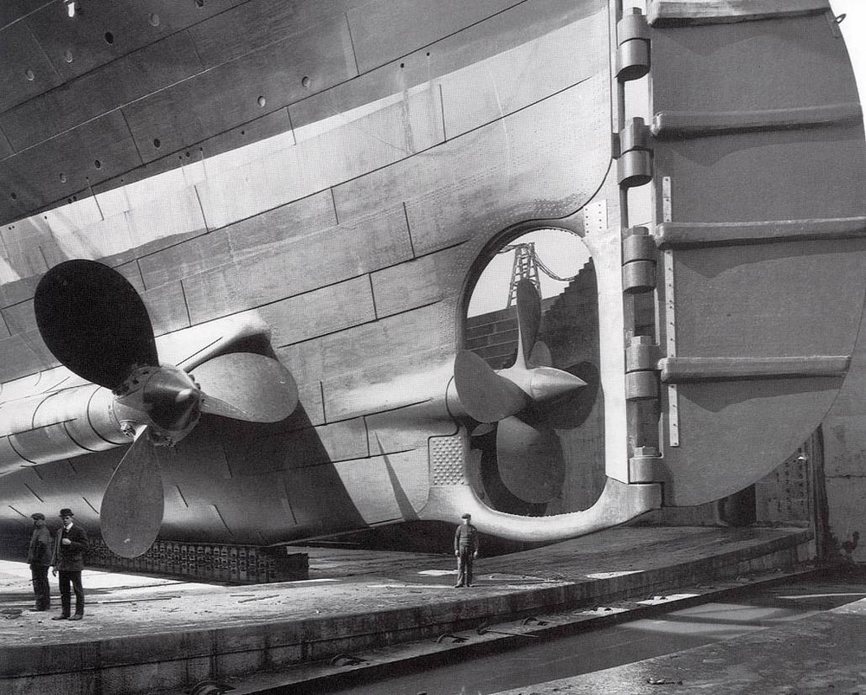
3
propellers
2
secondary: 3 blades
1
primary: 4 blades
Propellers
Notes:
Titanic was equipped with a steam powered triple screw (another term for propeller) propulsion system to ensure it moved across the ocean at a respectable pace of approximately 22 knots. Stopping at nothing to provide the best experience, the blades were deliberately pitched at such an angle so that the ship would not vibrate, discomfort, or distract the passengers from the more elegant points of Titanic’s voyage on board when enjoying the smoking and dining rooms. Titanic’s propellers were all crafted from brass. Note the center screw has four blades whilst the port and starboard have three.
As a result of the pitch of the propeller’s blades, Titanic ran at a slightly slower speed than it could have, but if you wanted sheer speed there were alternatives. Other ocean liners might get you from England to New York faster, but if it was pure elegance, luxury, and dominance of the ocean, Titanic was the ticket for you.

Slide 7
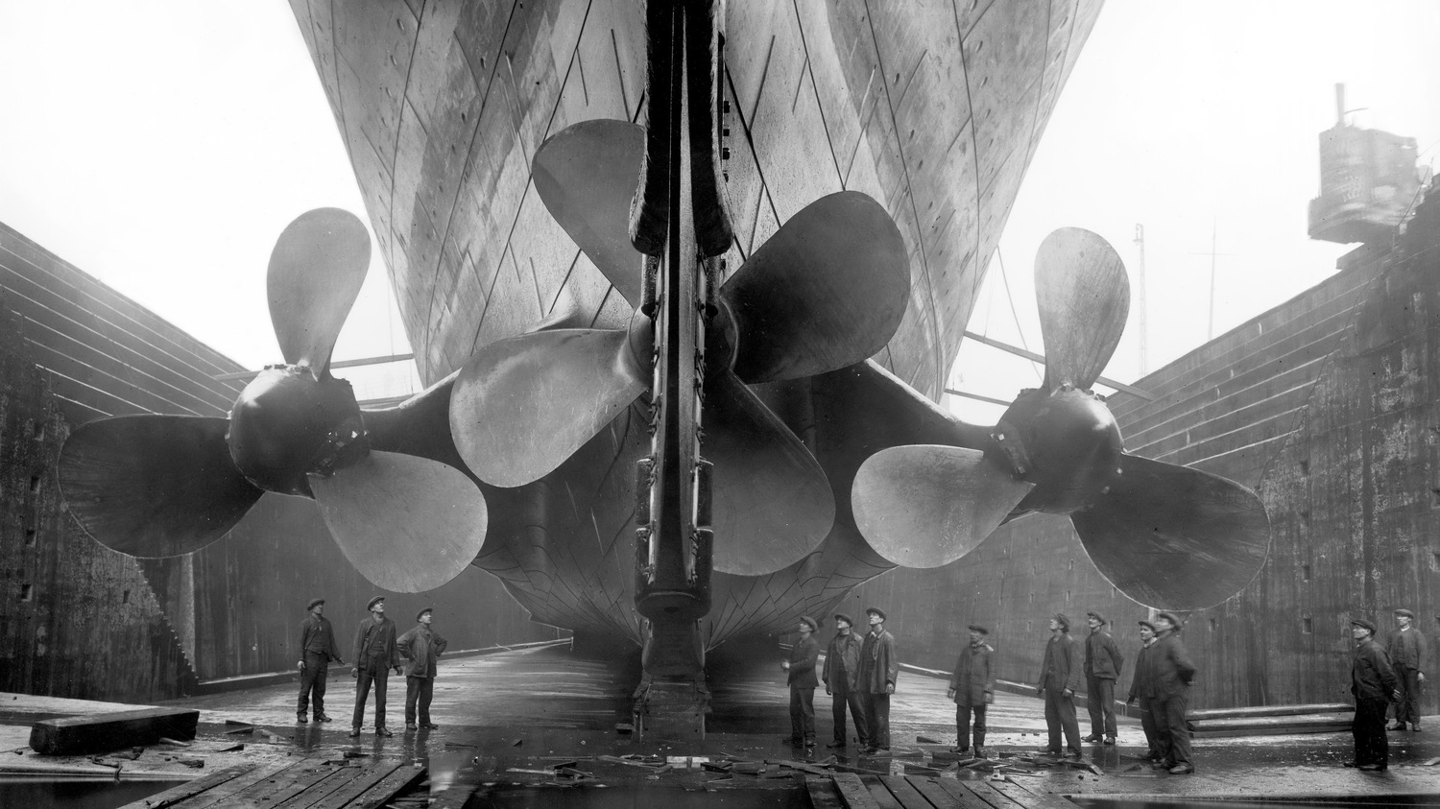
Notes:
This is one of my favorite images captured during the building of Titanic. The sheer size and scale of the ship is on full display here as you can see the workers peering up at the three propellers as it sits in dry dock at Harland & Wolff Shipyards in Belfast.

Slide 8
Completion

Slide 9
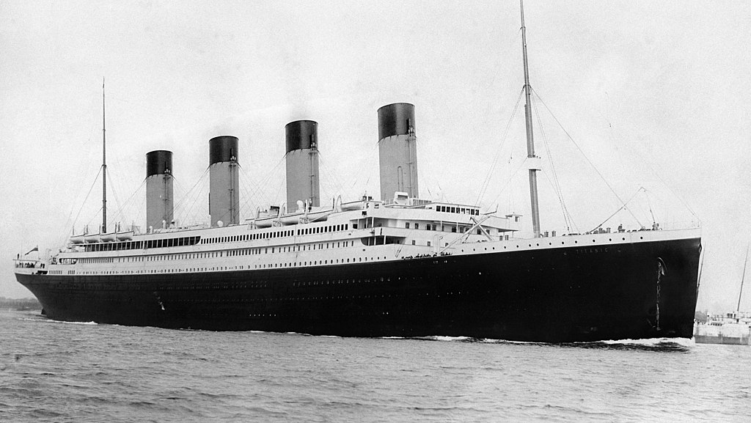
882 feet long
That’s almost three football fields. It also weighed 52,310 tons.

Slide 10
Research Questions
How many total crew members were there and how many survived?
How many were men and how many were women?
In which parts of the ship did they work?
Notes:
It is now time to start digging into the data questions I had about the crew members of Titanic, and I will use this section by framing out the research questions I had and show the corresponding data analysis. In particular, I will be showing visualizations that will look to provide a much more detailed view into the crew data.

Slide 11
Crew Survival Rate
Notes:
One of the first questions I had regarding the crew members of Titanic is what was their survival rate?
The story is well known that during the sinking of Titanic, more than 1,500 people — 1,517 to be exact — lost their lives. The really unfortunate part of this tragedy is that it shouldn’t have happened — for numerous reasons — most especially that the ship didn’t have enough lifeboats for all on board. Titanic was equipped to carry 64 lifeboats; however, the ship only actually set sail with 20 — and four of those were collapsible, a smaller, more easily storable type of boat. The total number of souls that the lifeboats could carry was 1,178 passengers and crew, but that number was still more than required by the 1883 Merchant Shipping Act. Still, just over 700 made it aboard lifeboats. In 1912, the tradition for loading lifeboats during an emergency was women and children first, and unfortunately, this tradition often caused time delays in filling the lifeboats as the women and children were singled out for priority in lifeboat placement, which often led to lifeboats being launched only half full, if that, amidst the chaos of a sinking ship. This was certainly the case with Titanic on that cold, April night with freezing temperatures on the Atlantic Ocean.

Slide 12
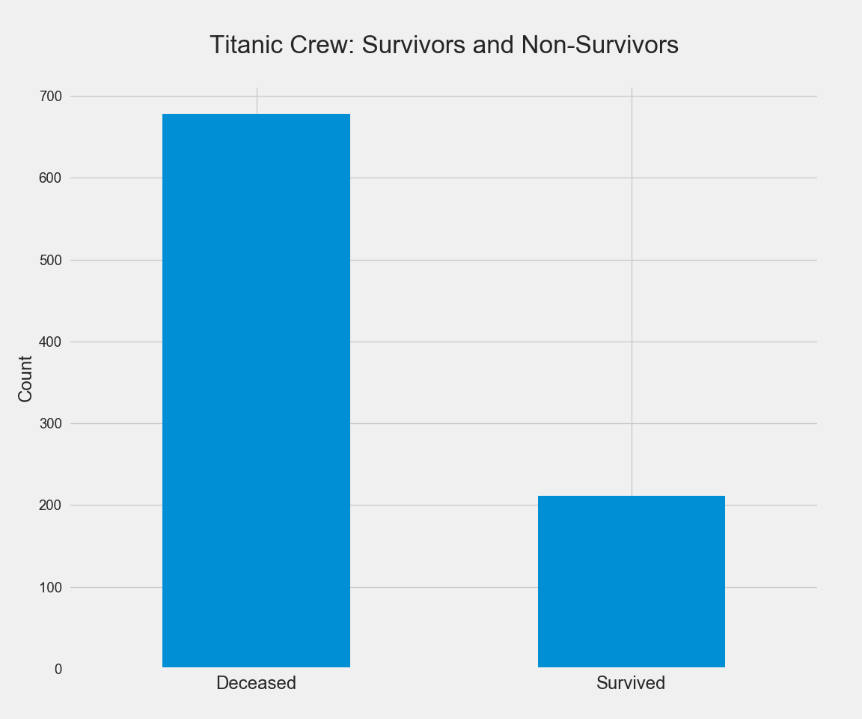
76%
deceased
24%
survived
Survival Rate
Notes:
It’s now time to tell the data story of Titanic’s crew members. From the total of 891 crew members, 679 did not survive, a survival rate of around 24%. From the ship’s passenger perspective, there were a total of 1,352 passengers aboard and 500 survived, a survival rate of 40%. The data tells us that the Titanic crew members had much less of a chance of surviving than the passengers did.

Slide 13
Crew Gender
Notes:
To answer the research question of how many of the crew members were men and how many were women, let’s again turn to a bar chart

Slide 14
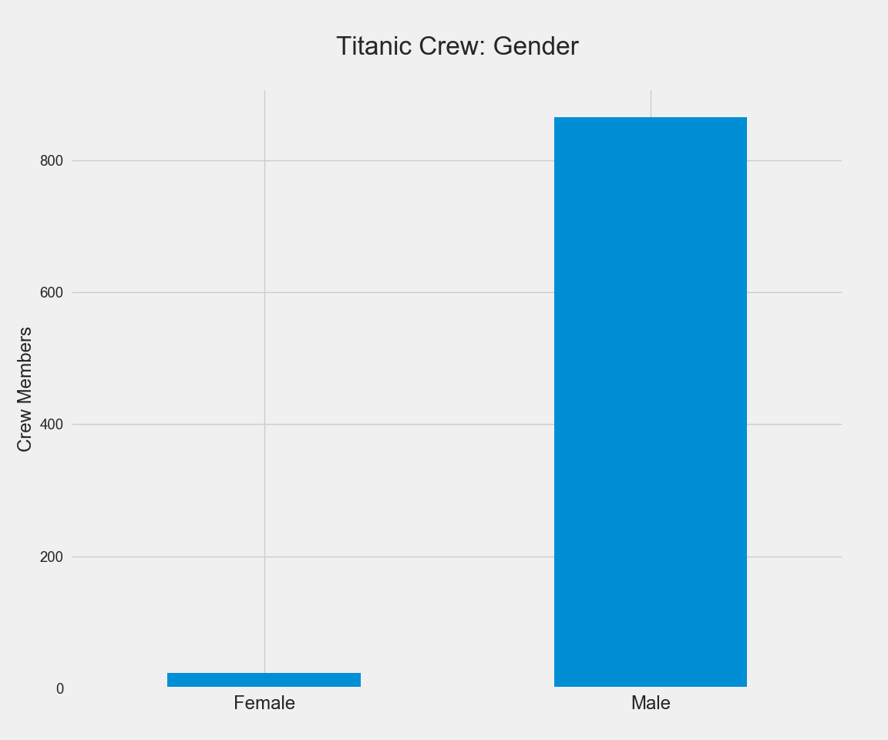
23
female
868
male
Gender
Notes:
These numbers surprised me a bit. Looking at the data, the number of male crew members aboard the Titanic’s maiden voyage far outnumbered the women. In fact, of the 891 crew members, only 23 were women. Why such a large discrepancy? For that we should look more into the different departments that worked aboard the ship.

Slide 15
Crew Departments
Notes:
Here’s a look at the Titanic crew data showing the different departments that worked aboard the ship.

Slide 16
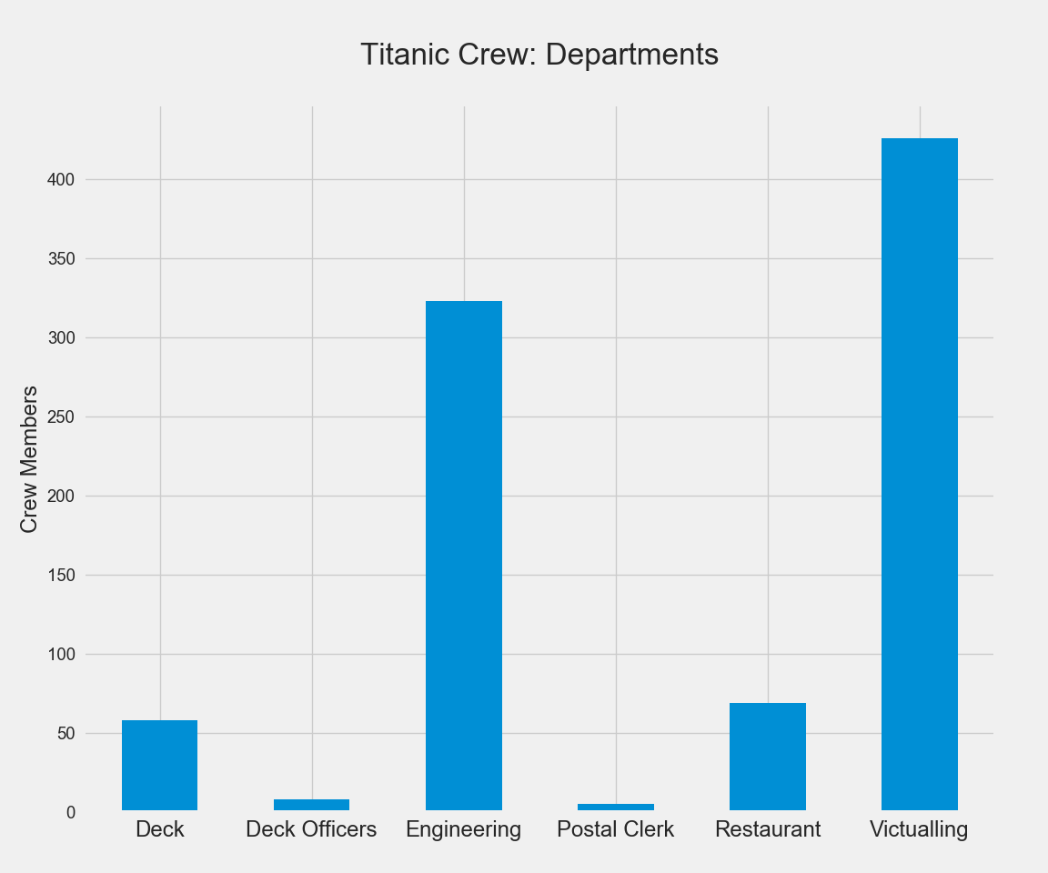
Departments
Notes:
This information shows that most of the crew members of Titanic were in the victualling department; this is the department that provides all the services for the occupants of the ship: food, housekeeping, laundry, room service, etc.
The next highest amount of crew members aboard Titanic were engineers. The engineers were responsible for keeping the engines, generators, and other mechanical equipment on the ship running. They were also the highest paid members of the crew (not counting the officers) and had the education and technical expertise to operate, maintain, and repair the engineering plant.

Slide 17
Survivors: Crew Departments
Notes:
Now let’s look at some of the same data showing just survivors of the sinking. Here’s a look at the Titanic crew data showing the different departments that worked aboard the ship.

Slide 18
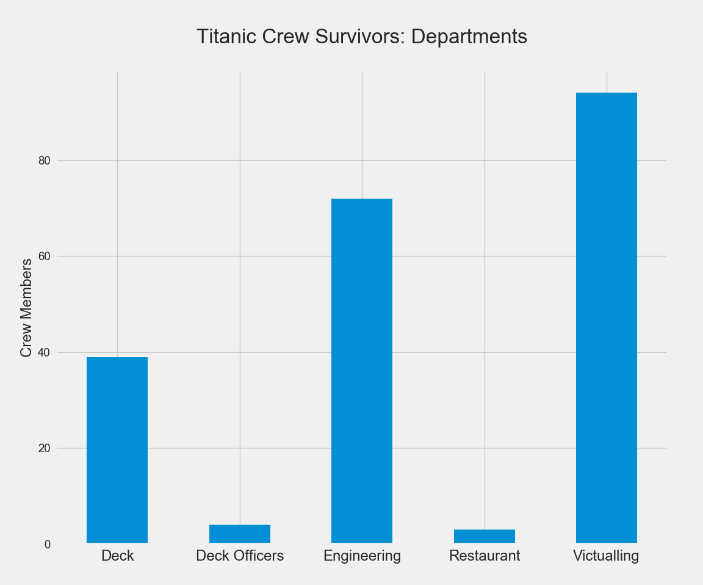
Survivors:
Departments
Notes:
This chart looks a bit different that the listing of all crew members. You can see that all five of the postal clerks aboard the ship did not survive, and that while a good majority of the deck crew did, many of the members of the engineering and victualling departments did not.

Slide 19
Survivors: Crew Gender
Notes:
One final chart, this showing the crew survivors by gender

Slide 20
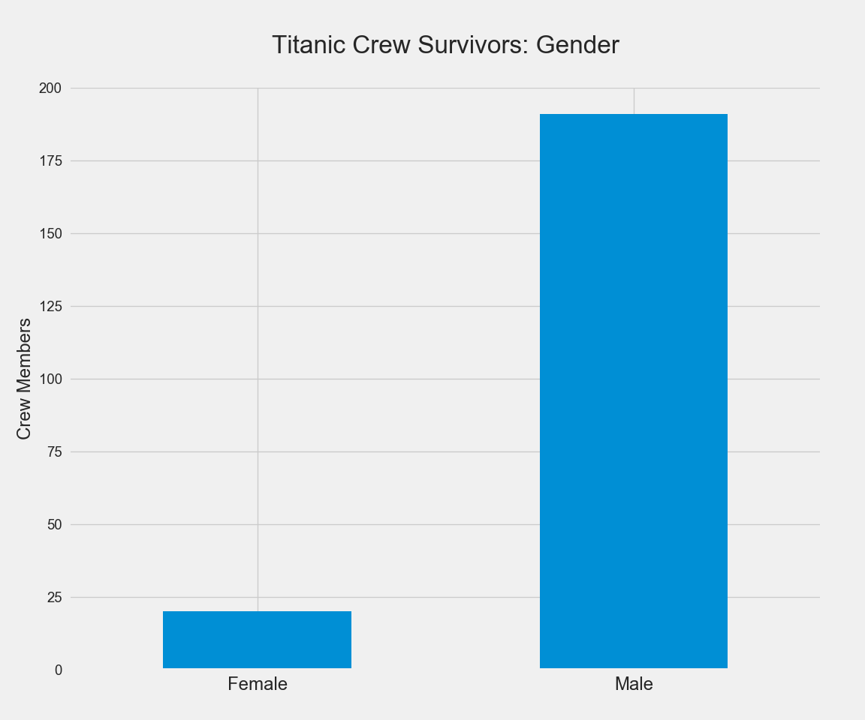
20
female
192
male
Survivors:
Gender
Notes:
Of the 23 crew members aboard Titanic that were women, 20 of them survived the disaster, right around 87%, whereas of the 868 men, 192 of them survived, a rate of 22%.

Slide 21
Conclusion
Notes:
There were many people that died when RMS Titanic sank on its maiden voyage in April 1912, including those who were crew members, employed by the White Star Line to service the passengers on the ship. After exploring data on the crew members to look for any trends in the data from those that survived the disaster, some items stood out.
Titanic crew members’ survival rate (24%) was almost half that of the passengers (40%). Additionally, there were only 23 women crew members out of the 891 total, and 20 of them survived, an 87% survival rate. Regarding crew department and survival rate, those with less seniority and status as far as department were most likely to perish in the disaster. A fair amount of the ship’s deck crew survived, most likely because they were put in charge of manning the lifeboats, and also assigned to them as rowers as they were lowered to the ocean during the calamity. Unfortunately, the majority of the workers who were in lower parts of the ship — especially right above the hull (bottom) where the boilers were located did not survive. All five of the postal clerks aboard the ship perished, most likely due to the mailroom being one of the first rooms impacted by the iceberg strike and first to become flooded with freezing sea water.

Slide 22
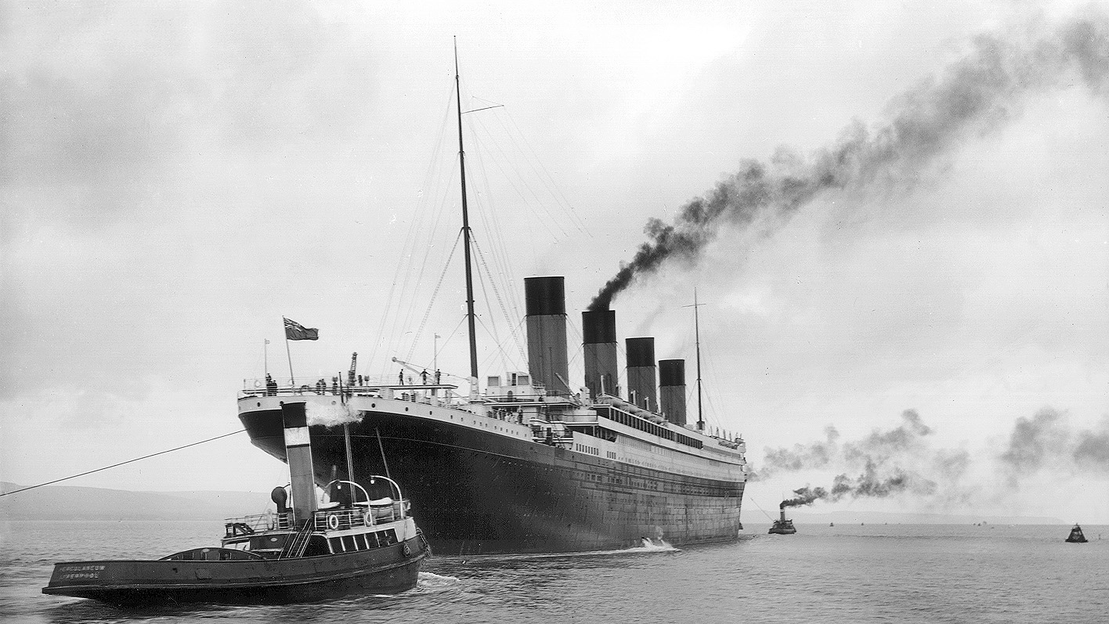
Notes:
Thank you for walking through this data exploration with me!

